Slide 1
Customer Segmentation Analysis

Slide 2
Executive Summary
In this case study, a company has planning for customer loyalty program. In order for the program to run effectively, the company asks you as Sales Manager to create the right target customer from the existing transaction data. Due to this background, we need to analyze and create a segmentation that is in accordance with the transaction habits of our customers
Objectives :
Define the right number of customer groups / cluster based on the amount of spent value, the frequency over a certain period, and the last time they made a transaction.
Describe each cluster then evaluate the results of the analysis for learning and provide recommendations for loyalty programs
Result Summary :
Compared to the RFM method, the K-Means method is preferred chosen, because it is easier to interpret the characteristics of transaction behavior. From the results of K-Means, we also find a sufficient number of customers for loyalty program opportunities.

Slide 3


Data Introduction
The data used for analysis is data with a period of four years. It has transactions from January 1 2011 until April 31 2014. There were 51,290 transaction lines data during the period.
We have 24 columns consisting of customer identity (including area), place (outlet) and transaction date. The number of transactions and also the details of the items purchased (Brand-Category- Subcategory- ID product)
DataSource: Global_Superstore Data
Tools :
Google Colaboratory for Jupyter environment
Library Package for visualization

Slide 4
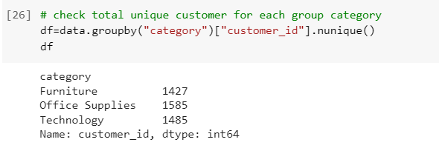
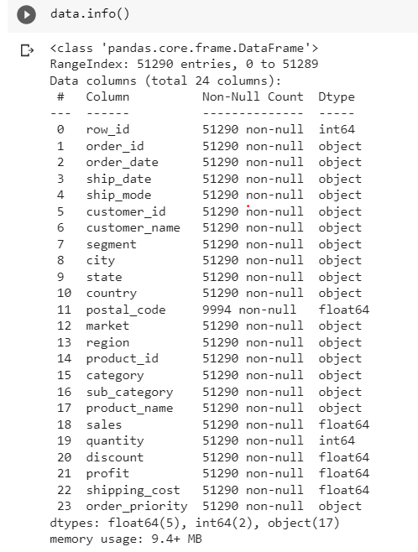
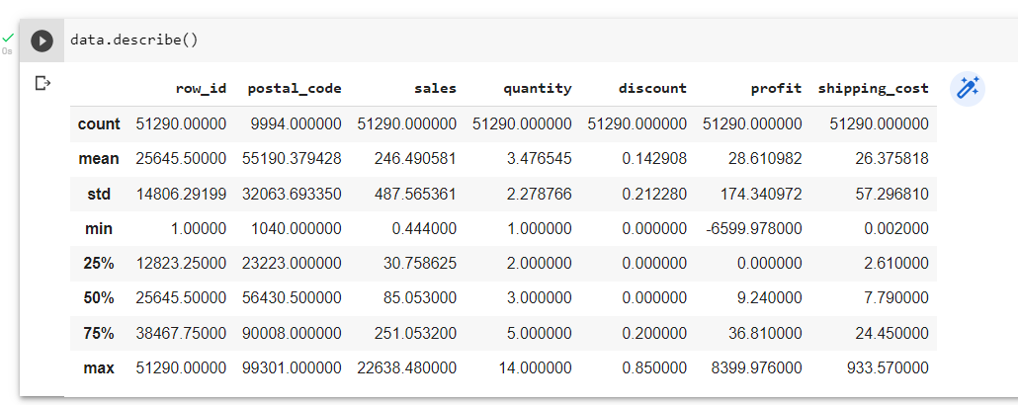
Explanatory Data Analysis 1
Check data type and missing value
There are no significant difference of total unique customer from each category
No issue in datatype and no null on each column. Except postal code, we can change to the type object. but its ok for don’t anything to this null rows
Check for max and min for quantity and discount to make sure that was make sense

Slide 5
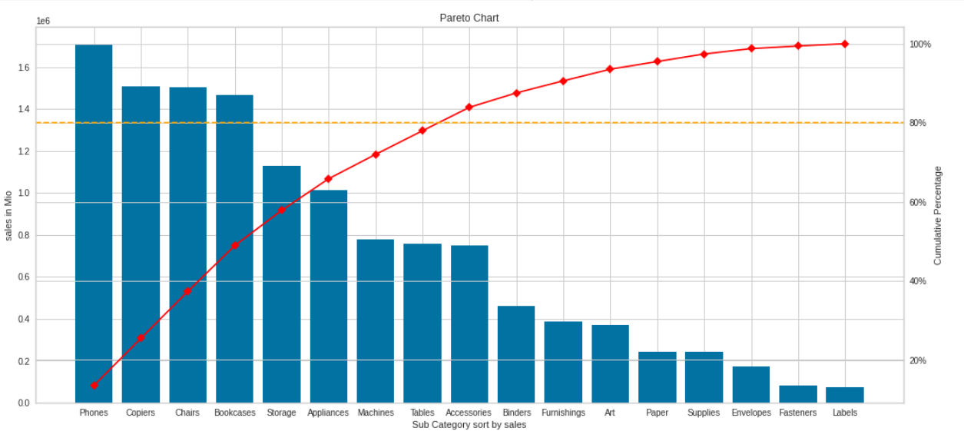
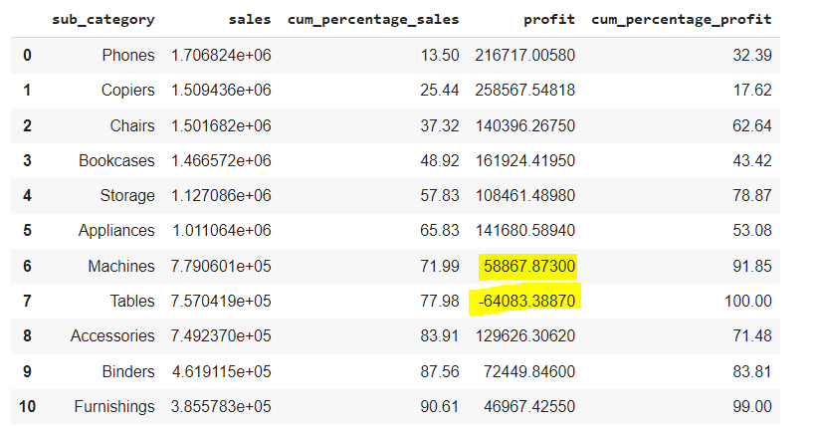
Explanatory Data Analysis 2
Create pareto to check top 80% sales contribution from category and subcategory
Check also profit for each top category from previous pareto.
Top Subcategory: Phones, Copiers, Chairs, Bookcases, Storage, Appliances, Machines, Tables, dan Accessories.
We can drop subcategory tables and Machines because they give minus profit contribution or bad on profit

Slide 6
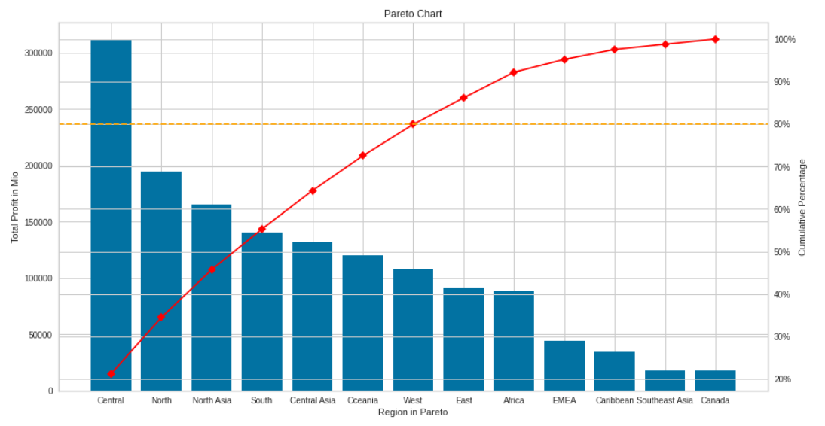
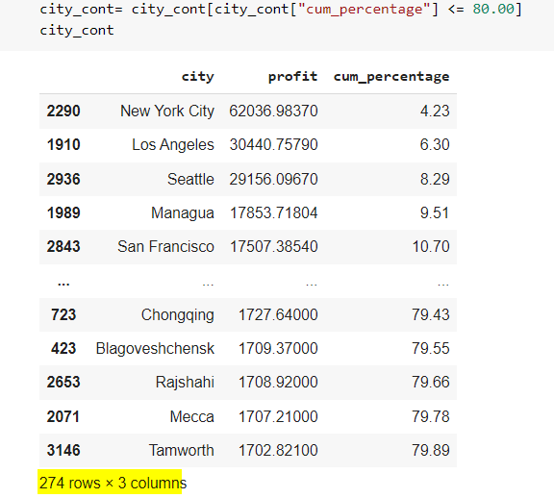
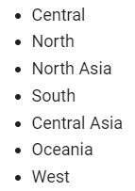
Explanatory Data Analysis 3
Create pareto to check top 80% profit contributors from Region and area
How about contribution from each city ?
From the chart there are 8 region as a top contributors :
From 3.636 city we found 274 top city. It will give us more insight for next step when cluster / segment customer has defined.

Slide 7
RFM ANALYSIS

Slide 8
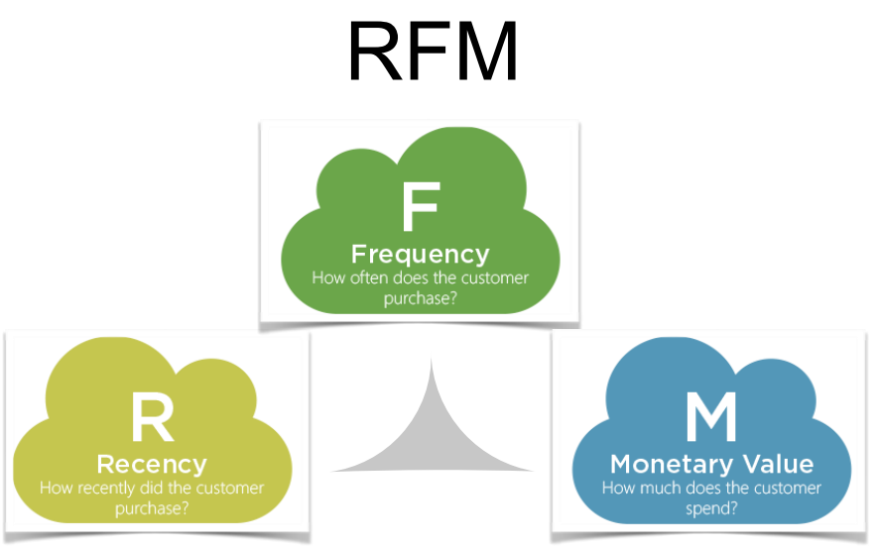

Slide 9
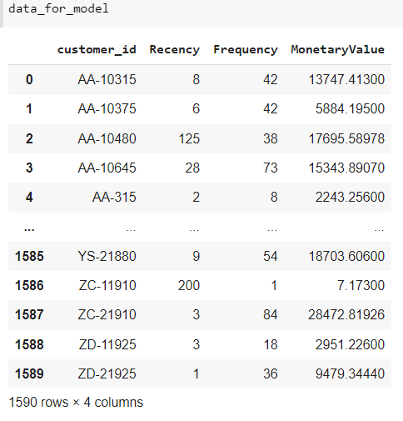
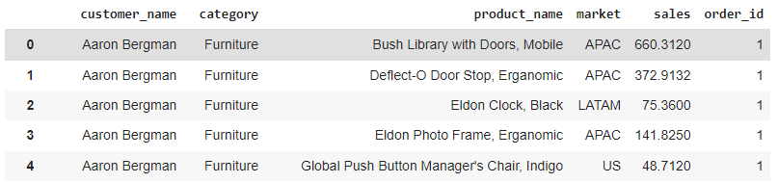
Create Data for Model
Transaction data that we have is still in the form of raw data. Where each customer can make multiple purchases for a variety of different products and even do transactions in different markets with different payment methods.
for above sample data: Aaaron Bergman bought five types of product in different markets and different total values
Meanwhile, to make this RFM model we need to know the behavior for each customer. so that we can assess the behavior of the transaction that makes the customer include to what cluster.
From 4 years period from data transaction, there are 1.590 unique customer id that we will check their recent transaction, much value they spent, and how often they doing transaction (frequency)

Slide 10
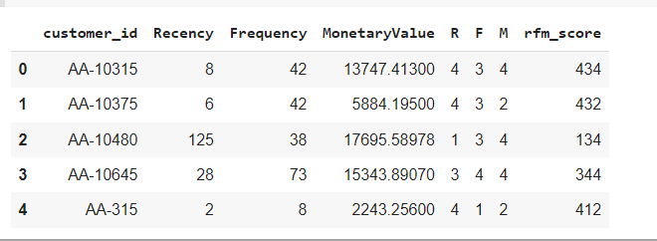
RFM Segmentation Score
As explained on the data introduction, we will analyze the whole of customer data, where the date of the period used is the last date of the transaction minus the start date (from all of transaction history) after calculating, the period is four years. Start on 1 Jan 2011 until 31 Dec 2014.
Each matrix that is measured has a different unit. Matrix Recency is the number of days from 31 Dec 2014 minus the last transaction date for each customer, therefore the unit is days.
Frequency is calculated as the number of transactions carried out in units of times.
and monetary spent is definitely the currency that was paid during the period and the result of the accumulation of spending many times.
So that each matrix (red box) must be converted into an ordinal scale (green box). 1 – 4 means worst to best, this scale is devided by quartiles. Then the RFM score for each customer can be calculated.
Now, we get the RFM Score for each customer ID, so let check the distribution of RFM Score!!

Slide 11
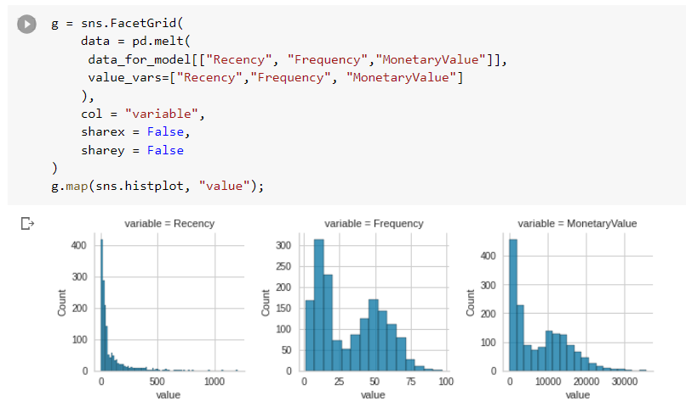
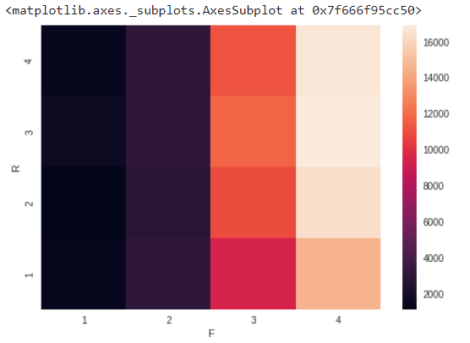
Post Segmentation Analysis
Heat Map Visualization
RFM Distribution
From recency distribution we found that most of transaction done at Quartile 1 value < 250, mostly have value= 0. that seems good for recency value.
Most of the last transactions have done at q1 value < 250, mostly frequency distribution show just little customers who have frequency more than 75 times. But this has good distribution on middle (Q2-Q3). we have to check spending of this middle customer. Whether is possible to upgrade to the loyal customer or not.
Using HeatMap we can see the correlation of RFM element. The brighter columns then RFM Score get better value.

Slide 12

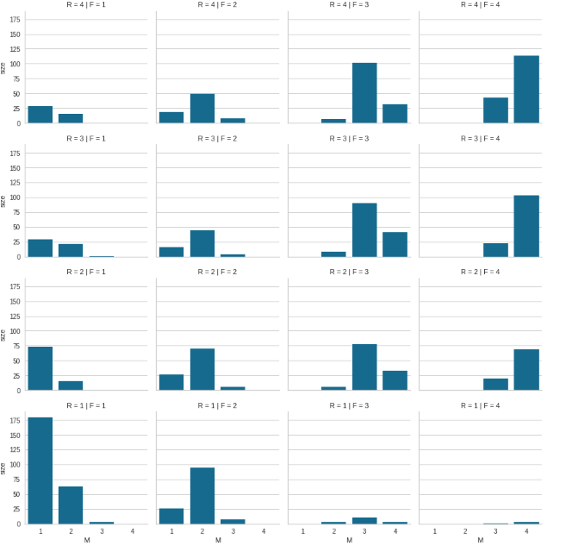
Post Segmentation Analysis
Basically, from the number of scales for each matrix, 64 types of RFM scores can be created.
Champion
Totally 64 maximal type of RFM Score
However, as can be seen on left image, not all RFM scores are filled in. So we can group multiple RFMs into more interpretable group definitions.
Champion ( gold box) score 444: Best value on each element. has highest RFM Values.
Loyal Customer (red box) : one level under Champion. They have 3-4 values for RFM.
Promising (Yellow box): customers who have transactions often but still have small value. or rarely transact but once they spend a large amount.
Recent (Green box) : Customer whose transactions recent in very small amount.
Needing Attention (Pink Box) : customers who haven’t transacted in a long time
Can’t lose them (Blue Box) : customers who used to transact often but haven’t transact for a long time.
At risk (Purple Box) : customers who already at lowest level and are risk to churn
Lost (Black Box): Confirmed customer churn

Slide 13
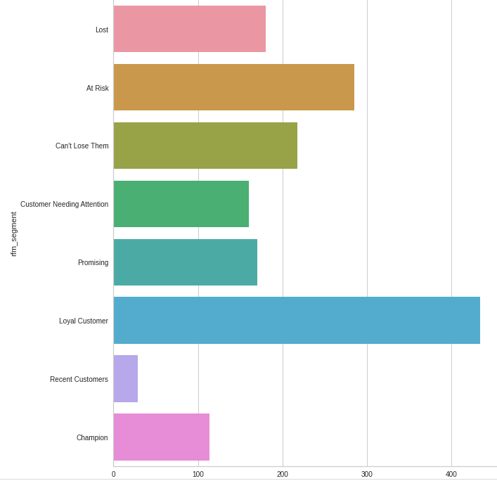
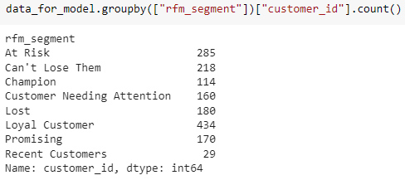
Post Segmentation Analysis
Check size for each segment
RFM Segmentation give us 8 clusters. Where the number of customers for the category of loyal customers is 434 customers, 27 % from total Customers
all this loyal customers can be assessed further to increase, so that it will become a Champion.
The second largest number after loyal customers are customers in the "At Risk" group. This also needs certain treatment so that it doesn't fall into the "Lost" group.
Different treatments will be adjusted to every customer group. If the company wants to give each of these treatment, the consideration is that the costs incurred are also getting bigger.

Slide 14
K-Means Clustering

Slide 15
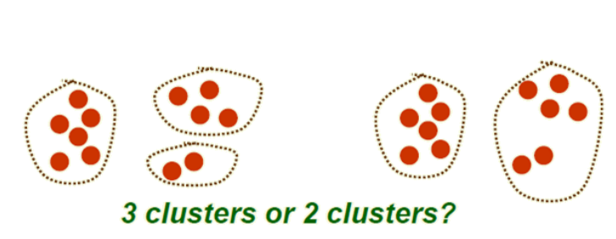
K-Means Clustering
Use mean value from each cluster to find middle point
Initiate random point every time we run the algorithm (need to seed the RNG)
Manually set the number of segments we want
K-Means Method is sensitive to the outliers and only applicable if mean is defined.

Slide 16
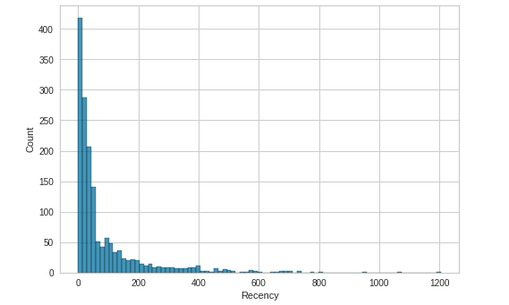
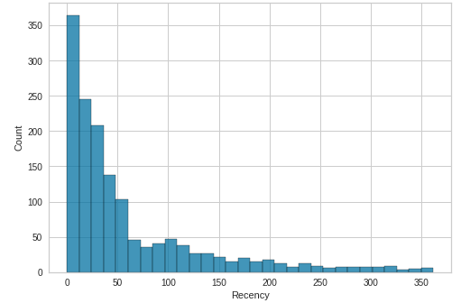
Prepared data for K-Means Clustering
The distribution picture above shows a very large difference between the number of customers with a recency of 0-200 compared to the number of customers with a recency of over 360 days (one years), only 75 customers with a recency > 300 days, or only 5% of the total.
This 5% will be take out from the analysis, so that data recency which is too low does not interfere to the mean values of between clusters. The Recency period is also will be more valid, because 95% of the last transactions from all customers are in the last year.

Slide 17
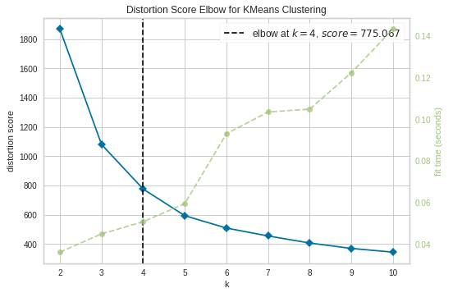
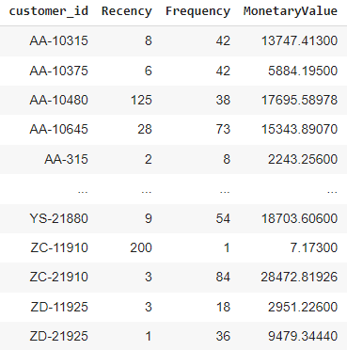
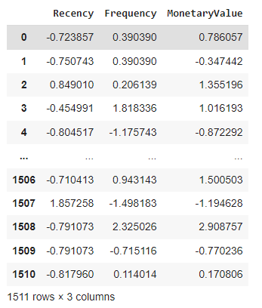
Define Cluster Optimal with Elbow Method
The K-means method was sensitive to the variance, so it had to be reduced by the Standard Scaler.
With the elbow method we will quickly find out the optimal cluster point because this method has calculated the average point distance between clusters.
The principle of a good optimal cluster is when the distance between clusters is getting bigger but the distance of the points in one cluster is getting smaller.

Slide 18
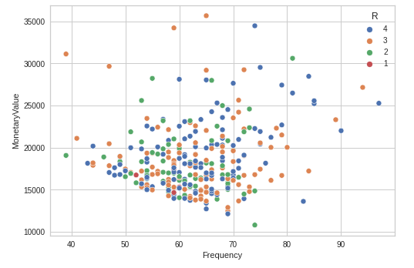
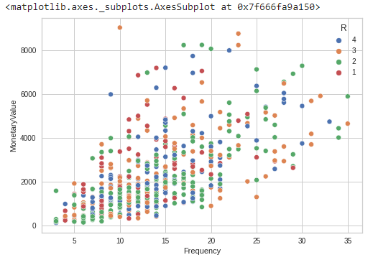
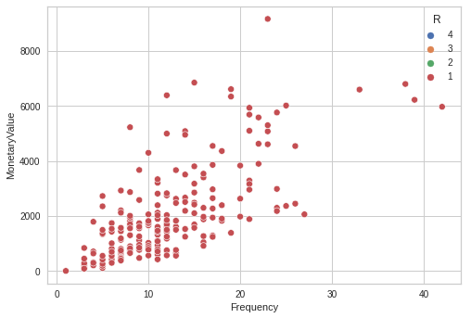
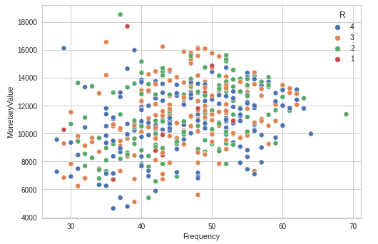
Result K-Means Cluster
Cluster 0
Cluster 1
The most frequency range = 5-25 times , with the last transaction in the second quarter quite a lot. The most spent under the number 400.
This cluster can be considered as a Gold Customer where the transaction frequency is quite high 50-80 times even up to the 90s. and also enormous monetary value. Especially in the range of 800-1600 customers which is quite high.
Cluster 2
Cluster 3
This cluster has a pretty good recency, seen from the blue dots, where the spent value is also quite high. Especially in the range of 8000 - 15000. Very potential to be upgraded to Gold Customer.
This cluster can be considered a cluster that is very risky for churn. Apart from not transacting for a long time (last in Q1) and the group who spent in Q1 with nominal under 200 - 300 is quite a lot.

Slide 19
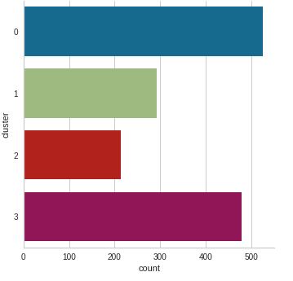
Cluster Analysis and Recommendation
# Customers of Each K-Means Cluster
Due to models tested (RFM and K-Means) I would recommend K-Means as a clustering model. where the transaction data period used is only the last year's transaction data. described earlier in the K-Means analysis.
The K-Means cluster is easier to interpret to create future business opportunities.
Then from this K-Means segmentation, you can also check what product clusters or subcategories are most frequently purchased. And it can be seen which region has a greater probability of buying it according to Pareto data.
Cluster 3 can be used as a new opportunity for retention so that they can become more loyal to provide more intensive promotions because the monetary value of customers in cluster 3 is quite large even though the frequency is as high as customers in Cluster 1
Meanwhile, Cluster 0 where the potential loyal customers are still below Cluster 3. needs to be considered because there are quite a lot of customers above 500 customers. which is a shame if you have to stop trading in Q2 and Q3.
and customers in Clusters 1 and 3 if seen are also quite a lot. With nearly 500 customers in cluster 3. Cluster 1 has almost 300 customers. This is a great opportunity for the Customer loyalty program
Potential Loyal Customer
Gold Customer
Risk to Churn
Loyal Customer

Slide 20
Thank You

